Slide 1


Providing Safe Care for the Suicidal Patient
Choose Mon Health. Feel The Difference.

Slide 2
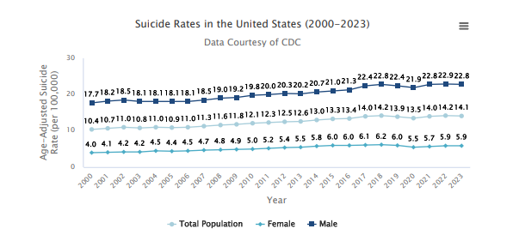
Statistics
According to the Centers for Disease Control and Prevention (CDC) WISQARS Leading Causes of Death Reports, in 2023:
Suicide was the eleventh leading cause of death overall in the United States, claiming the lives of over 49,300 people.
Suicide was the second leading cause of death among individuals between the ages of 10 and 34 and the fourth leading cause of death among individuals between the ages of 35 and 44.
There were over two times as many suicides (49,316) in the United States as there were homicides (22,830).

Slide 3
Regulatory Guidelines
The Joint Commission and DNV:
The hospital identifies safety risks inherent to patient population.
Suicide of a patient while in a staffed, round-the-clock care setting is a frequently reported type of sentinel event.
Identification of individuals at risk for suicide while under the care of or following discharge from a healthcare organization is an important step in protecting these at-risk individuals.
CMS § 482.13 Condition of participation: Patient's rights
A hospital must protect and promote each patient's rights.
https://www.cms.gov/Regulations-and-Guidance

Slide 4
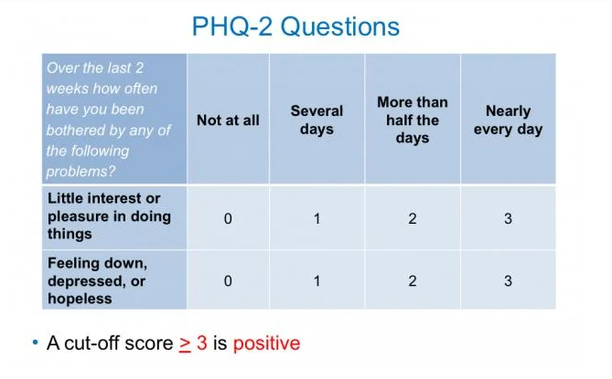
Assessment Tool- PHQ-2
These positive patients will need a complete PHQ-9 assessment.

Slide 5
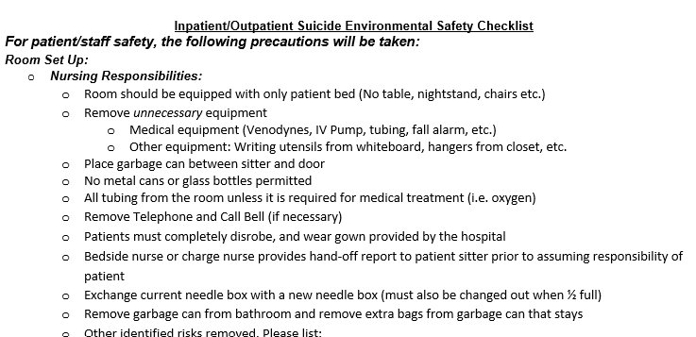
Environmental Safety
Once a patient is determined to be at high risk for suicidal ideation, protecting and securing the patient’s environment becomes imperative.
What Can You Do?
Complete the “Environmental Safety Checklist” every shift
Be aware of ligature risks in the room (necessary medical equipment, call bell, etc.)
Place patient in a hospital gown
Secure belongings in a locked closet or with Security
Ensure any unnecessary equipment in the room is removed
(ex: IV pumps, tubing, Venodynes, hangers, etc.)

Slide 6

Sitter Responsibilities
The sitter will maintain constant visual observation of the patient.
Evidenced with q15 minute documentation
Sitter observes the patient and maintains a safe environment.
All visitor interactions with the patient will be observed by the sitter.
Escalate suspicious activity.
Sitter accompanies the patient for any clinical tests or procedures off the unit.
Patient will not be left un-observed in the bathroom for any reason. Bathroom door must remain open while maintaining CVO or provide bedside commode then remove from room.
The sitter will be provided a hospital issued phone or be positioned near the bedside phone.
The sitter should position themselves between the patient and the door, to ensure safety.
Personal cell phone use is not permitted while sitting with a patient.
The sitter will monitor the patient’s behavior, both verbal and body language, and immediately report any expressions of self-harm, harm to others, or intent to leave the facility without authorization.

Slide 7
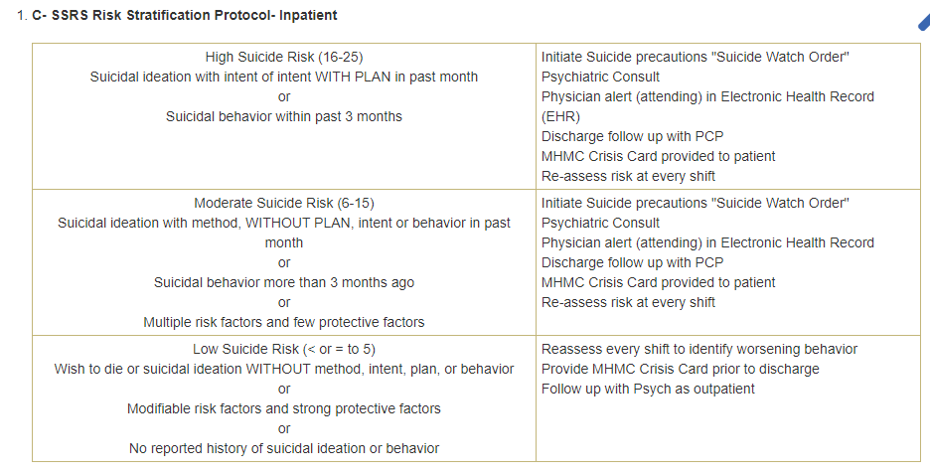
Columbia Protocol Risk Stratification Tool / Elopement- Inpatient

Slide 8
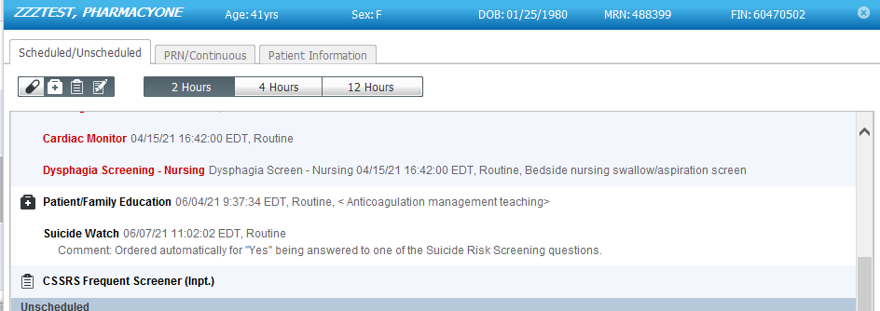
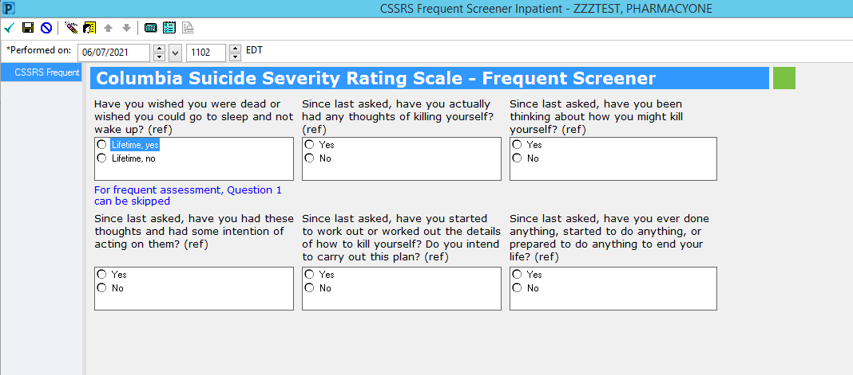
Frequent Screener Tool – MHMC, Marion & SJMH Only
Once a patient is determined at risk and placed on suicide watch, the patient should be reassessed every shift to determine level of risk.
If patient is determined to be at a lower risk: contact provider for reassessment.
Only a provider can discontinue suicide watch. ​

Slide 9
Nursing Responsibilities
Complete a PHQ questionnaire and follow policy: “Depression and Suicidal Risk Assessment and Safety”.
If patient determined to be high risk: Implement 1:1 immediately.
Provide a report of risk and care plan to the assigned sitter.
Update the Provider, Security, and House Supervisor if the patient behavior is suspicious or escalating.
Complete a re-assessment using the “CSSRS Frequent Screener” ad hoc form every shift once the patient is determined at risk (MMC, MMNH & SJMH).
Complete the handoff sheet at the end of every shift to verify proper documentation.
Ensure the “Crisis Card” is provided to the patient prior to discharge.
Assess patient behavior during family/friend visitation.
Verify documentation is completed (crisis card, sitter, reassessments).

Slide 10
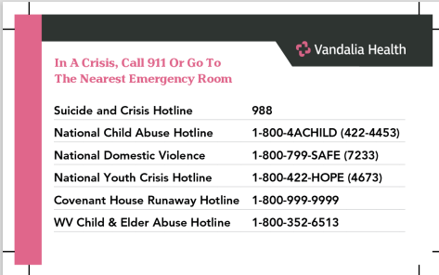
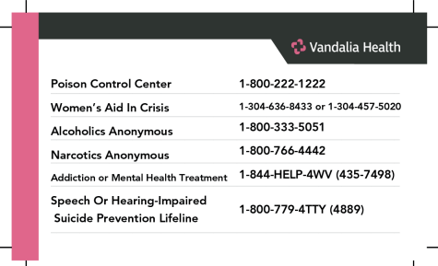
Vandalia Health Crisis Card

Slide 11
For Questions or Concerns
Contact your Manager or the Risk Management Department

